Slide 1
Travelling Salesman Problem
Group 53
Done By:
Wayne, Yi Xiang, Kieron, Yi Xiong, Li Ming
Notes:
Good Afternoon everyone, my name is Wayne and with me I have Yi Xiang, Kieron, Yi Xiong and Li Ming. Together we will present our findings and results for the Travelling Salesman Problem.

Slide 2
Video
https://youtu.be/RRVQnWeLU8Y

Slide 3
Outline
What is the TSP
TSP
Data set
Project Objectives
Dynamic Programming
Explain algorithm
Show results
RL
Explain algorithm
Show results
Comparison between algorithms

Slide 4
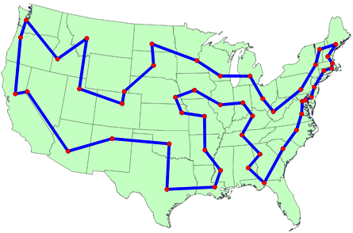
Travelling Salesman Problem
Traveling Salesman Problem (TSP) is a classic optimization problem in computer science and operations research
The goal is to find the shortest possible route that visits each city exactly once and returns to the origin city, forming a complete loop.
Notes:
What is the Traveling Salesman Problem? The Traveling Salesman Problem or TSP for short, is a classic optimization problem in computer science and operations research. The goal is to find the shortest possible route that visits each city exactly once and returns to the origin city, forming a complete loop.

Slide 5
Project Statement
Develop a solution to the Traveling Salesman Problem (TSP) using advanced optimization techniques. The project involves designing and implementing algorithms to find the shortest possible route that visits a given set of cities exactly once and returns to the starting city. The project will also include visualizing the optimal route on a map and comparing the performance of different algorithms.

Slide 6
Project Objective
Implement and test algorithms for solving the Traveling Salesman Problem to find the optimal route for a dataset of up to 20 cities. The objective is to provide a detailed comparison of the Dynamic Programming approach with Reinforced Learning based on accuracy and computational efficiency.

Slide 7
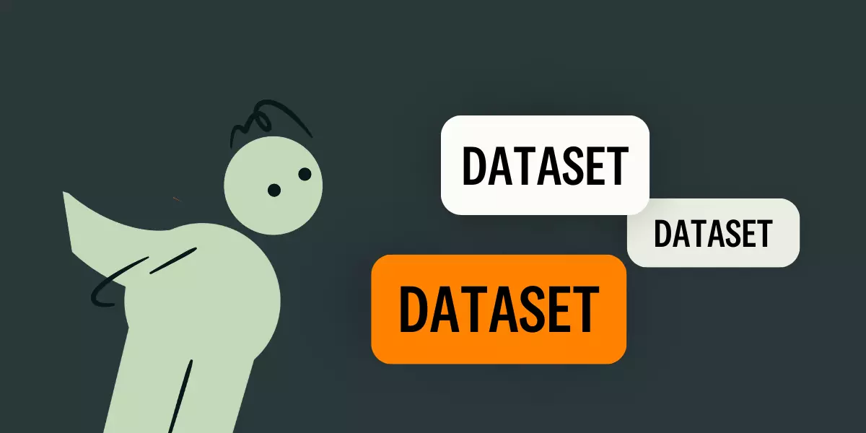
Test Plan
For our input dataset, we have chosen xqf131 from the list TSP instances provided by Andre Rohe, based on VLSI design studies from the Forschungsinstitut für Diskrete Mathematik at Universität Bonn
Realistic Distances, uses Euclidean metrics, and distances rounded to 2 decimal place, balancing accuracy with usability
Selected testing cities will be from 5 to 20 cities from the xqf131 dataset
Notes:
For this project, we selected the dataset xqf13 provided by Andre Rohe We chose this dataset because it provides realistic distances that represents practical spatial representations, and simplicity of data with distances rounded to whole numbers. Since the dataset we are using is large, we will only be using the first 20 entries from the dataset to save time (and our machines).

Slide 8
Dynamic Programming
Dynamic Programming (DP) is a method for solving complex problems by breaking them down into simpler subproblems.
Two approaches : Tabulation, Memoization
Notes:
Dynamic Programming (DP) is a method for solving complex problems by breaking them down into simpler subproblems. There are two approaches to DP, Tabulation and Memoization.

Slide 9
Dynamic Programming (Tabulation)
Solves smallest subproblems first.
Builds up solutions to larger subproblems.
Avoids deep recursion and stack overflow issues.
Efficiently accesses previously computed subproblems.
Notes:
Tabulation is particularly useful for solving the TSP because it handles smaller subproblems first and builds up to the overall solution. This approach avoids the pitfalls of deep recursion and makes it easy to access previously computed results, reducing redundant calculations.

Slide 10
Dynamic Programming (Memoization)
Solves larger subproblems first by breaking them down recursively.
Uses caching to avoid redundant calculations.
Efficiently handles overlapping subproblems.
Avoids deep recursion issues with careful implementation.
Notes:
For this project, we went with Memoization. Memoization is particularly useful for solving the TSP because it breaks down larger subproblems recursively and uses caching to store results, avoiding redundant calculations. This approach efficiently handles overlapping subproblems and avoids deep recursion issues with careful implementation.

Slide 11
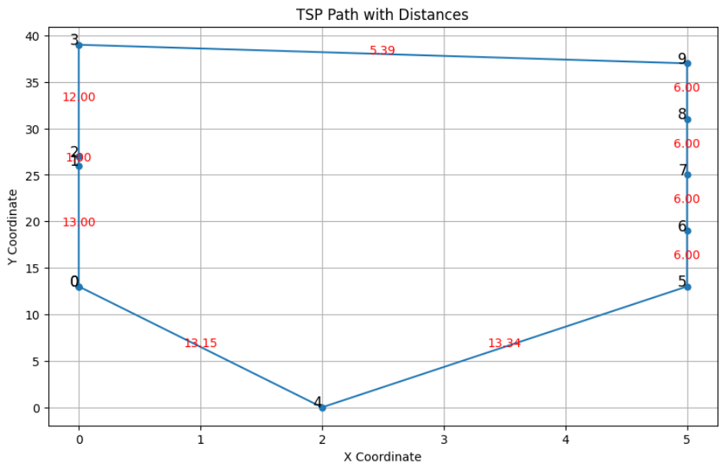

Dynamic Programming Result (10 Cities)
Notes:
This is the graph generated when we test our code with 10 cities. The time taken to execute is 0.02 seconds and the minimum cost is 81.88.

Slide 12
Reinforcement Learning (Q-Learning)
Q-Learning is a reinforcement learning Algorithm used to find optimal solution in environments where an agent learns to make decision through trial and error.
Core idea of Q-Learning is to estimate the value of taking a specific action in a given state, which is represented by a Q-value.
Q(s,a) ← Q(s,a) + 𝛼[𝑟 + 𝛾 max𝑎′𝑄(𝑠′,𝑎′) − 𝑄(𝑠,𝑎)]
𝑠 is the current state. 𝑎 is the action taken. r is the reward received after taking action 𝑎 in state 𝑠. 𝑠′ is the new state after action. 𝑎′ is any possible action from the new state 𝑠′. 𝛼 is the learning rate (0 < α ≤ 1). 𝛾 is the discount factor (0 ≤ γ < 1).
Notes:
Q-Learning is a reinforcement learning Algorithm used to find optimal solution in environments where an agent learns to make decision through trial and error.
Core idea of Q-Learning is to estimate the value of taking a specific action in a given state, which is represented by a Q-value.
Using the formula below, the agent will iteratively explore and updates its Q value to learn the best actions to take in each state to maximise overall reward

Slide 13
Q-Learning Improvements Made
Epsilon (ε) in Q-Learning:
Determines probability of choosing a random action
ε = 0.1 → 10% chance of random action
ε-Greedy Method:
Balances exploration (random actions) and exploitation (best-known actions)
Random number > ε → Explore: Select random unvisited city (Exploration)
Random number ≤ ε → Exploit: Select city with highest Q-value (Exploitation)
Decaying Epsilon Strategy:
Start with high ε for more exploration
Gradually decrease ε over time
Transition from exploration to exploitation
Enhances thorough exploration early on and optimal decision-making later
Notes:
In Q-Learning, epsilon (ε) determines the probability of choosing a random action rather than the best-known action. An e value of 0.1 means there is a 10% chance of selecting a random action.
In our Q-Learning implementation, we’ve made several key improvements to enhance its effectiveness:
Firstly is ε-greedy which helps balance exploration and exploitation . This method generate a random number. If this number is greater than e value, the algorithm selects a random city from the list of unvisited cities. Otherwise, it chooses the city with the highest Q-value.
To enhance this method, I've implemented a decaying epsilon strategy. Initially, e value is set to a higher value, allowing for more exploration. Over time, e value gradually decreases, reducing the likelihood of random actions and encouraging the algorithm to exploit the best-known actions more frequently. This approach helps the algorithm explore the environment thoroughly in the early stages and focus on optimizing the solution in the later stages.

Slide 14
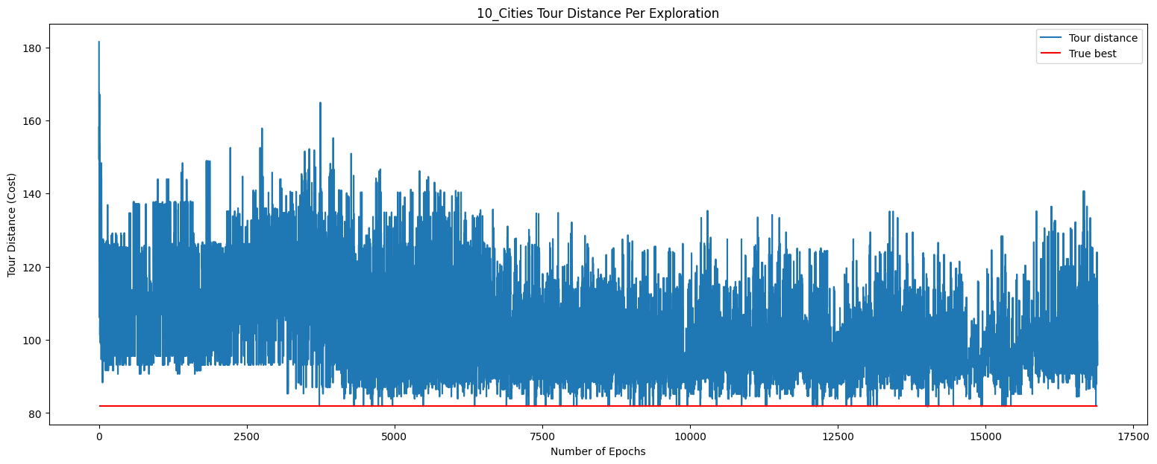
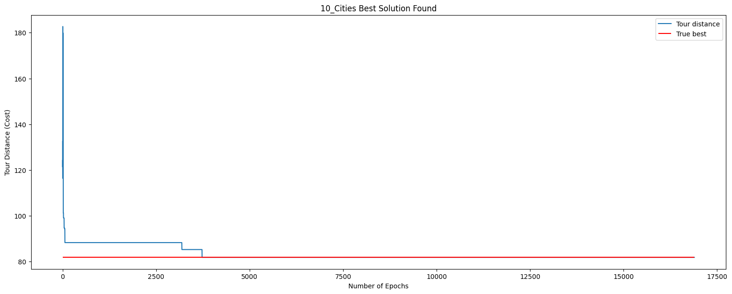
Q-Learning Training (10 Cities)
Notes:
From the top image we can see at each iteration of the Q learning training progress. At the start of the training the cost is not as optimal as it focus more on exploration whereas at the ending part it start to exploit the optimal path.
And from the bottom image, we can tell that around 3000+ epoch(or iteration) of the Q learning training phase, the algorithm have already found the most optimal solution but will still continue to train until the stopping criteria is met which is 10000 iteration where there is no improvement to the cost

Slide 15
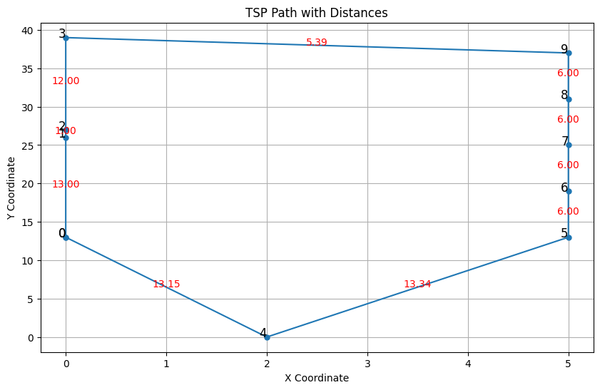

Q-Learning Result (10 Cities)
Notes:
This is the result of the most optimal path for the 10 cities using Q learning where the best cost of 81.88
Next i will pass the time to kieron

Slide 16
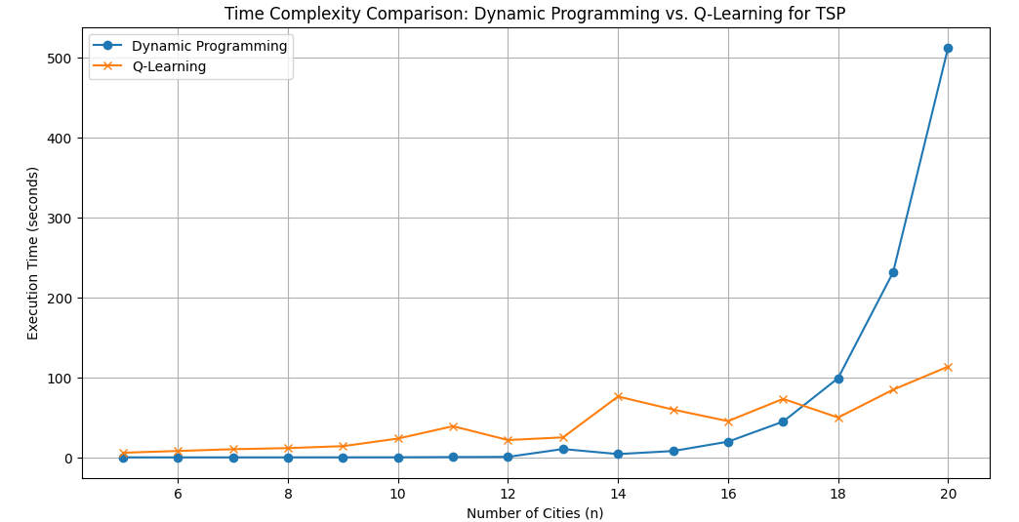
Dynamic Programming Vs Q-Learning (Time Complexity)
Q - Learning | Dynamic Programming
Quadratic: O(E × n²) | Exponential: O(n² × 2ⁿ)
Q - Learning would provide better scalability in larger datasets compared to dynamic programming
Q - Learning will generally be more efficient for larger datasets while dynamic programming will quickly become impractical
Notes:
E is the number of episode and n is the number of city Hi i am kieron and i will be going over the comparison of the 2 algos
We will start with time complexity
Q - Learning has a quadratic time complexity, while DynamicProgramming has a Exponential time complexity,
this graph paints a very vibrant picture of how DynamicProgramming might be more efficient in smaller datasets
but quickly grows inefficient when dealing with larger datasets.
In larger datasets it will be more efficient to use Q learning to achieve better time complexity

Slide 17
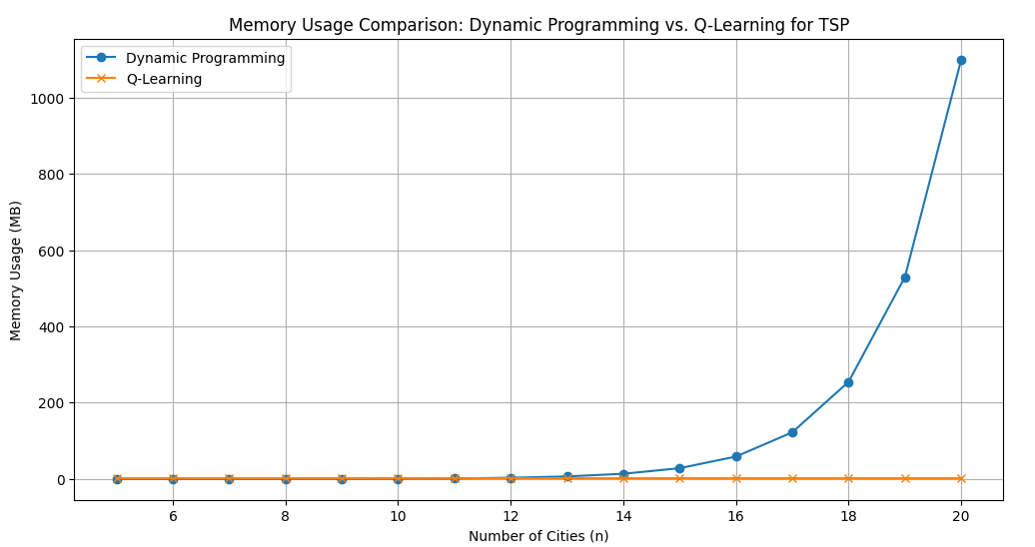
Dynamic Programming Vs Q-Learning (Space Complexity)
Q - Learning | Dynamic Programming
Quadratic: O(n²) | Exponential: O(n⋅2ⁿ)
Q-Learning space complexity is O(n²) This is primarily due to the Q-table, which stores state-action values for each pair of cities.
The space complexity is O(n⋅2ⁿ) because we need to store results for all 2ⁿ subsets of cities and each subset has up to n possible ending cities.
Q - Learning would be more practical in larger datasets where the input size is large as DP will require excessive memory and time requirements
Notes:
The Space Complexity graph shows a very similar story,
where in smaller datasets,
we have similar results with both algorithms,
but in larger datasets DynamicProgramming
quickly grows impractical due to the excessive memory and time requirements

Slide 18
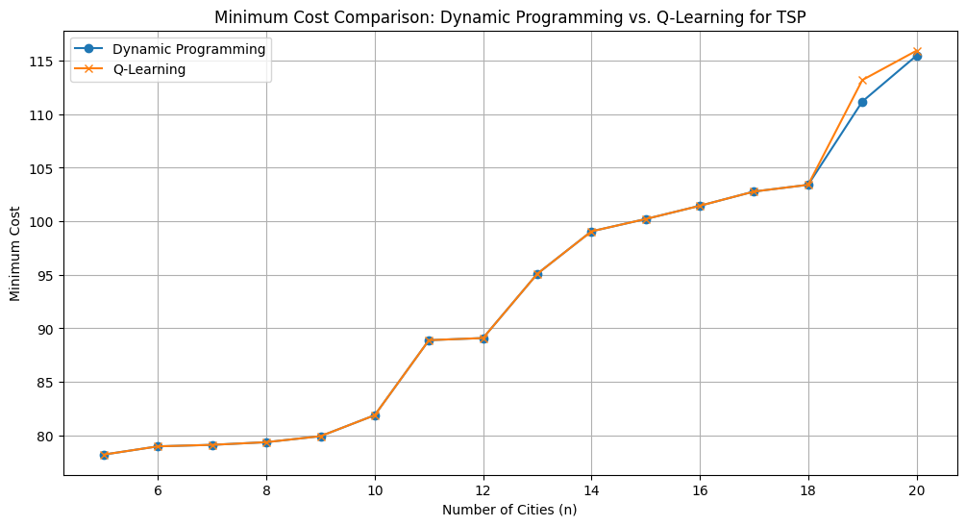
Dynamic Programming Vs Q-Learning (Minimum Cost Result)
Q - Learning | Dynamic Programming
Sub-Optimal Route | Optimal Route
Dynamic Programming would provide the best route while Q Learning might not give the most optimal solution all the time due the inherent randomness in the algorithm
With Larger datasets, it is possible that it might take Q - Learning many more iterations to find a near optimal route due to its inherent randomness.
Notes:
Now Lets compare our min cost result
given all it’s drawbacks of taking more resources and time in large datasets,
Dynamic Programming is able to guarantee the optimal route,
while Q - Learning cannot because it is a greedy alorithm and because of its inherent randomness,
Q learning will just find a best possible solution that might or might not be the optimal route.
Next i will hand over to Li Ming

Slide 19
Travelling Salesman Problem
Done By:
Wayne, Yi Xiang, Kieron, Yi Xiong, Li Ming
Notes:
Good Afternoon everyone, my name is Wayne and with me I have Yi Xiang, Kieron, Yi Xiong and Li Ming. Together we will present our findings and results for the Travelling Salesman Problem.

Slide 20
Outline
What is the TSP
TSP
Data set
Project Objectives
Dynamic Programming
Explain algorithm
Show results
RL
Explain algorithm
Show results
Comparison between algorithms

Slide 21
Travelling Salesman Problem
Traveling Salesman Problem (TSP) is a classic optimization problem in computer science and operations research
The goal is to find the shortest possible route that visits each city exactly once and returns to the origin city, forming a complete loop.
Notes:
What is the Traveling Salesman Problem? The Traveling Salesman Problem or TSP for short, is a classic optimization problem in computer science and operations research. The goal is to find the shortest possible route that visits each city exactly once and returns to the origin city, forming a complete loop.

Slide 22
Project Statement
Develop a solution to the Traveling Salesman Problem (TSP) using advanced optimization techniques. The project involves designing and implementing algorithms to find the shortest possible route that visits a given set of cities exactly once and returns to the starting city. The project will also include visualizing the optimal route on a map and comparing the performance of different algorithms.

Slide 23
Project Objective
Implement and test algorithms for solving the Traveling Salesman Problem to find the optimal route for a dataset of up to 20 cities. The objective is to provide a detailed comparison of the Dynamic Programming approach with Reinforced Learning based on accuracy and computational efficiency.

Slide 24
Test Plan
For our input dataset, we have chosen xqf131 from the list TSP instances provided by Andre Rohe, based on VLSI design studies from the Forschungsinstitut für Diskrete Mathematik at Universität Bonn
Realistic Distances, uses Euclidean metrics, and distances rounded to 2 decimal place, balancing accuracy with usability
Selected testing cities will be from 5 to 20 cities from the xqf131 dataset
Notes:
For this project, we selected the dataset xqf13 provided by Andre Rohe We chose this dataset because it provides realistic distances that represents practical spatial representations, and simplicity of data with distances rounded to whole numbers. Since the dataset we are using is large, we will only be using the first 20 entries from the dataset to save time (and our machines).

Slide 25
Dynamic Programming
Dynamic Programming (DP) is a method for solving complex problems by breaking them down into simpler subproblems.
Two approaches : Tabulation, Memoization
Notes:
Dynamic Programming (DP) is a method for solving complex problems by breaking them down into simpler subproblems. There are two approaches to DP, Tabulation and Memoization.

Slide 26
Dynamic Programming (Tabulation)
Solves smallest subproblems first.
Builds up solutions to larger subproblems.
Avoids deep recursion and stack overflow issues.
Efficiently accesses previously computed subproblems.
Notes:
Tabulation is particularly useful for solving the TSP because it handles smaller subproblems first and builds up to the overall solution. This approach avoids the pitfalls of deep recursion and makes it easy to access previously computed results, reducing redundant calculations.

Slide 27
Dynamic Programming (Memoization)
Solves larger subproblems first by breaking them down recursively.
Uses caching to avoid redundant calculations.
Efficiently handles overlapping subproblems.
Avoids deep recursion issues with careful implementation.
Notes:
For this project, we went with Memoization. Memoization is particularly useful for solving the TSP because it breaks down larger subproblems recursively and uses caching to store results, avoiding redundant calculations. This approach efficiently handles overlapping subproblems and avoids deep recursion issues with careful implementation.

Slide 28
Dynamic Programming Result (10 Cities)
Notes:
This is the graph generated when we test our code with 10 cities. The time taken to execute is 0.02 seconds and the minimum cost is 81.88.

Slide 29
Reinforcement Learning (Q-Learning)
Q-Learning is a reinforcement learning Algorithm used to find optimal solution in environments where an agent learns to make decision through trial and error.
Core idea of Q-Learning is to estimate the value of taking a specific action in a given state, which is represented by a Q-value.
Q(s,a) ← Q(s,a) + 𝛼[𝑟 + 𝛾 max𝑎′𝑄(𝑠′,𝑎′) − 𝑄(𝑠,𝑎)]
𝑠 is the current state. 𝑎 is the action taken. r is the reward received after taking action 𝑎 in state 𝑠. 𝑠′ is the new state after action. 𝑎′ is any possible action from the new state 𝑠′. 𝛼 is the learning rate (0 < α ≤ 1). 𝛾 is the discount factor (0 ≤ γ < 1).
Notes:
Q-Learning is a reinforcement learning Algorithm used to find optimal solution in environments where an agent learns to make decision through trial and error.
Core idea of Q-Learning is to estimate the value of taking a specific action in a given state, which is represented by a Q-value.
Using the formula below, the agent will iteratively explore and updates its Q value to learn the best actions to take in each state to maximise overall reward

Slide 30
Q-Learning Improvements Made
Epsilon (ε) in Q-Learning:
Determines probability of choosing a random action
ε = 0.1 → 10% chance of random action
ε-Greedy Method:
Balances exploration (random actions) and exploitation (best-known actions)
Random number > ε → Explore: Select random unvisited city (Exploration)
Random number ≤ ε → Exploit: Select city with highest Q-value (Exploitation)
Decaying Epsilon Strategy:
Start with high ε for more exploration
Gradually decrease ε over time
Transition from exploration to exploitation
Enhances thorough exploration early on and optimal decision-making later
Notes:
In Q-Learning, epsilon (ε) determines the probability of choosing a random action rather than the best-known action. An e value of 0.1 means there is a 10% chance of selecting a random action.
In our Q-Learning implementation, we’ve made several key improvements to enhance its effectiveness:
Firstly is ε-greedy which helps balance exploration and exploitation . This method generate a random number. If this number is greater than e value, the algorithm selects a random city from the list of unvisited cities. Otherwise, it chooses the city with the highest Q-value.
To enhance this method, I've implemented a decaying epsilon strategy. Initially, e value is set to a higher value, allowing for more exploration. Over time, e value gradually decreases, reducing the likelihood of random actions and encouraging the algorithm to exploit the best-known actions more frequently. This approach helps the algorithm explore the environment thoroughly in the early stages and focus on optimizing the solution in the later stages.

Slide 31
Q-Learning Training (10 Cities)
Notes:
From the top image we can see at each iteration of the Q learning training progress. At the start of the training the cost is not as optimal as it focus more on exploration whereas at the ending part it start to exploit the optimal path.
And from the bottom image, we can tell that around 3000+ epoch(or iteration) of the Q learning training phase, the algorithm have already found the most optimal solution but will still continue to train until the stopping criteria is met which is 10000 iteration where there is no improvement to the cost

Slide 32
Q-Learning Result (10 Cities)
Notes:
This is the result of the most optimal path for the 10 cities using Q learning where the best cost of 81.88
Next i will pass the time to kieron

Slide 33
Dynamic Programming Vs Q-Learning (Time Complexity)
Q - Learning | Dynamic Programming
Quadratic: O(E × n²) | Exponential: O(n² × 2ⁿ)
Q - Learning would provide better scalability in larger datasets compared to dynamic programming
Q - Learning will generally be more efficient for larger datasets while dynamic programming will quickly become impractical
Notes:
E is the number of episode and n is the number of city Hi i am kieron and i will be going over the comparison of the 2 algos
We will start with time complexity
Q - Learning has a quadratic time complexity, while DynamicProgramming has a Exponential time complexity,
this graph paints a very vibrant picture of how DynamicProgramming might be more efficient in smaller datasets
but quickly grows inefficient when dealing with larger datasets.
In larger datasets it will be more efficient to use Q learning to achieve better time complexity

Slide 34
Dynamic Programming Vs Q-Learning (Space Complexity)
Q - Learning | Dynamic Programming
Quadratic: O(n²) | Exponential: O(n⋅2ⁿ)
Q-Learning space complexity is O(n²) This is primarily due to the Q-table, which stores state-action values for each pair of cities.
The space complexity is O(n⋅2ⁿ) because we need to store results for all 2ⁿ subsets of cities and each subset has up to n possible ending cities.
Q - Learning would be more practical in larger datasets where the input size is large as DP will require excessive memory and time requirements
Notes:
The Space Complexity graph shows a very similar story,
where in smaller datasets,
we have similar results with both algorithms,
but in larger datasets DynamicProgramming
quickly grows impractical due to the excessive memory and time requirements

Slide 35
Dynamic Programming Vs Q-Learning (Minimum Cost Result)
Q - Learning | Dynamic Programming
Sub-Optimal Route | Optimal Route
Dynamic Programming would provide the best route while Q Learning might not give the most optimal solution all the time due the inherent randomness in the algorithm
With Larger datasets, it is possible that it might take Q - Learning many more iterations to find a near optimal route due to its inherent randomness.
Notes:
Now Lets compare our min cost result
given all it’s drawbacks of taking more resources and time in large datasets,
Dynamic Programming is able to guarantee the optimal route,
while Q - Learning cannot because it is a greedy alorithm and because of its inherent randomness,
Q learning will just find a best possible solution that might or might not be the optimal route.
Next i will hand over to Li Ming

Slide 36
Conclusion
Notes:
In Conclusion, Dynamic Programming & reinforcement learning have their pros & cons.

Slide 37
Dynamic Programming
Pros | Cons
Able to get optimal route/solutions Possibly more efficient and reliable with small datasets | Uses high amounts of memory space exponential time complexity making it inefficient with large data sets with many inputs
Notes:
For Dynamic Programming, it is much more accurate, especially with small datasets. But it has high memory space demands, and it is inefficient with large datasets.

Slide 38
Reinforcement Learning (Q-Learning)
Pros | Cons
Simple and Flexible Suitable for data where updates occur (e.g. traffic updates) | Does not guarantee optimal solution Difficult to balance exploration and exploitation which may lead to suboptimal solution May require a large number of iteration to find the optimal solution Less accurate as the problem become more complex
Notes:
Reinforcement learning meanwhile is simple, flexible and adaptable( Pros point 2 summarized broadly). But it is not as accurate/optimal as Dynamic Programming, while also becomes less efficient with larger or complex datasets

Slide 39
THANK YOU!

Slide 40
References
Picture (Slide 3) - https://optimization.cbe.cornell.edu/index.php?title=Traveling_salesman_problem
Picture (Slide 4) - https://kili-technology.com/data-labeling/machine-learning/create-dataset-for-machine-learning

Slide 41
Conclusion
Notes:
In Conclusion, Dynamic Programming & reinforcement learning have their pros & cons.

Slide 42
Dynamic Programming
Pros | Cons
Able to get optimal route/solutions Possibly more efficient and reliable with small datasets | Uses high amounts of memory space exponential time complexity making it inefficient with large data sets with many inputs
Notes:
For Dynamic Programming, it is much more accurate, especially with small datasets. But it has high memory space demands, and it is inefficient with large datasets.

Slide 43
Reinforcement Learning (Q-Learning)
Pros | Cons
Simple and Flexible Suitable for data where updates occur (e.g. traffic updates) | Does not guarantee optimal solution Difficult to balance exploration and exploitation which may lead to suboptimal solution May require a large number of iteration to find the optimal solution Less accurate as the problem become more complex
Notes:
Reinforcement learning meanwhile is simple, flexible and adaptable( Pros point 2 summarized broadly). But it is not as accurate/optimal as Dynamic Programming, while also becomes less efficient with larger or complex datasets

Slide 44
THANK YOU!

Slide 45
References
Picture (Slide 3) - https://optimization.cbe.cornell.edu/index.php?title=Traveling_salesman_problem
Picture (Slide 4) - https://kili-technology.com/data-labeling/machine-learning/create-dataset-for-machine-learning

